Slide 1

Reflection and Annotations
SoftUni Team
Technical Trainers
Software University
https://softuni.bg

Slide 2

Table of Contents
Reflection - What? Why? Where?
Reflection API
Reflecting Classes
Reflecting Constructors
Reflecting Fields
Reflecting Methods
Access Modifiers
Reflecting Annotations

Slide 3
Have a Question?
sli.do
#java-advanced

Slide 4

Reflection

Slide 5
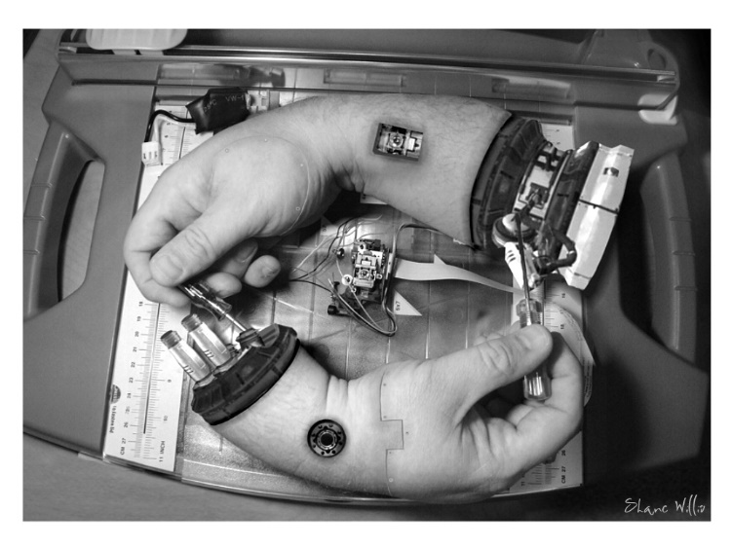
What is Metaprogramming?
Programming technique in which computer programs have the ability to treat programs as their data
Program can be designed to:
Read
Generate
Analyze
Transform
Modify itself while running

Slide 6

What is Reflection?
The ability of a programming language to be its own metalanguage
Programs can examine information about themselves
6

Slide 7
When to Use Reflection?
?
Whenever we want:
Code to become more extendible
To reduce code length significantly
Easier maintenance
Easier testing
7

Slide 8

When Not to Use Reflection?
If it is possible to perform an operation without using reflection, then it is preferable to avoid using it
Cons from using Reflection
Performance overhead
Security restrictions
Exposure of internal logic

Slide 9

Reflection API

Slide 10
The Class Object
Оbtain its java.lang.Class object
If you know the name
If you don't know the name at compile time
Class myObjectClass = MyObject.class;
Class myClass = Class.forName(className);
You need fully qualified class name as String

Slide 11
Class Name
Obtain Class name
Fully qualified class name
Class name without the package name
String className = aClass.getName();
String simpleClassName = aClass.getSimpleName();

Slide 12
Base Class and Interfaces
Obtain parent class
Obtain interfaces
Interfaces are also represented by Class objects in Java Reflection
Only the interfaces specifically declared implemented by a given class are returned
Class className = aClass.getSuperclass();
Class[] interfaces = aClass.getInterfaces();

Slide 13
Problem: Reflection
Import ReflectionClass to your src folder in your project
Using reflection you should print:
This class type
Super class type
All Interfaces
Instantiate object using reflection and print it
Don't change anything in class
Check your solution here :https://judge.softuni.bg/Contests/1604/Reflection-Lab

Slide 14
Solution: Reflection
Class<Reflection> aClass = Reflection.class;
System.out.println(aClass);
System.out.println(aClass.getSuperclass());
Class[] interfaces = aClass.getInterfaces();
for (Class anInterface : interfaces)
System.out.println(anInterface);
//Reflection ref = aClass.newInstance();//Deprecated since Java 9
Reflection ref = aClass.getDeclaredConstructor().newInstance();
System.out.println(ref);
Create new object
Notes:
There are two ways to achieve abstraction
- Using Abstract Classes
- Using Interfaces

Slide 15

Constructors, Fields and Methods

Slide 16
Constructors (1)
Obtain only public constructors
Obtain all constructors
Get constructor by parameters
Constructor[] ctors = aClass.getConstructors();
Constructor[] ctors =
aClass.getDeclaredConstructors();
Constructor ctor =
aClass.getConstructor(String.class);

Slide 17
Constructors (2)
Get parameter types
Instantiating objects using constructor
Class[] parameterTypes =
ctor.getParameterTypes();
Constructor constructor = MyObject.class.getConstructor(String.class);
MyObject myObject = (MyObject)constructor
.newInstance("arg1");

Slide 18
Fields Name and Type
Obtain public fields
Obtain all fields
Get field name and type
Field field = aClass.getField("somefield");
Field[] fields = aClass.getFields();
Field[] fields = aClass.getDeclaredFields();
String fieldName = field.getName();
Object fieldType = field.getType();

Slide 19
Fields Set and Get
Setting value for field
Class aClass = MyObject.class;
Field field = aClass.getDeclaredField("someField");
MyObject objectInstance = new MyObject();
field.setAccessible(true);
Object value = field.get(objectInstance);
field.set(objectInstance, value);
Change the behavior of the AccessibleObject
The objectInstance parameter passed to the get and set method should be an instance of the class that owns the field

Slide 20
Methods
Obtain public methods
Get methods without parameters
Method[] methods = aClass.getMethods();
Method method =
aClass.getMethod("doSomething",String.class);
Method method =
aClass.getMethod("doSomething", null);

Slide 21
Method Invoke
Obtain method parameters and return type
Get methods with parameters
Class[] paramTypes = method.getParameterTypes();
Class returnType = method.getReturnType();
Method method = MyObject.class
.getMethod("doSomething", String.class);
Object returnValue = method.invoke(null, "arg1");
null is for static methods

Slide 22
Problem: Getters and Setters
Using reflection get all methods and print:
Sort getters and setters alphabetically
Getters:
A getter method have its name start with "get", take 0 parameters, and returns a value
Setters:
A setter method have its name start with "set", and takes 1 parameter
Check your solution here :https://judge.softuni.bg/Contests/1604/Reflection-Lab

Slide 23
Solution: Getters
Method[] methods = Reflection.class.getDeclaredMethods();
Method[] getters = Arrays.stream(methods)
.filter(m -> m.getName().startsWith("get") &&
m.getParameterCount() == 0)
.sorted(Comparator.comparing(Method::getName))
.toArray(Method[]::new);
Arrays.stream(getters).forEach(m ->
System.out.printf("%s will return class %s%n",
m.getName(), m.getReturnType().getName()));
Notes:
There are two ways to achieve abstraction
- Using Abstract Classes
- Using Interfaces

Slide 24

Access Modifiers

Slide 25
Access Modifiers
Obtain the class modifiers like this
Еach modifier is a flag bit that is either set or cleared
You can check the modifiers
int modifiers = aClass.getModifiers();
getModifiers() can be called on constructors, fields, methods
Modifier.isPrivate(modifiers);
Modifier.isProtected(modifiers);
Modifier.isPublic(modifiers);
Modifier.isStatic(modifiers);
Notes:
There are two ways to achieve abstraction
- Using Abstract Classes
- Using Interfaces

Slide 26
Arrays
Creating arrays via Java Reflection
Obtain parameter annotations
Obtain fields and methods annotations
int[] intArray = (int[]) Array.newInstance(int.class, 3);
Array.set(intArray, 0, 123);
Array.set(intArray, 1, 456);
Class stringArrayComponentType =
stringArrayClass.getComponentType();
Notes:
There are two ways to achieve abstraction
- Using Abstract Classes
- Using Interfaces

Slide 27
Problem: High Quality Mistakes
You perfectly know how to write High Quality Code
Check Reflection class and print all mistakes in access modifiers which you can find
Get all fields, getters and setters and sort each category by name
First print mistakes in fields
Then print mistakes in getters
Then print mistakes in setters
Check your solution here :https://judge.softuni.bg/Contests/1604/Reflection-Lab

Slide 28
Solution: High Quality Mistakes
Field[] fields = Reflection.class.getDeclaredFields();
Arrays.stream(fields)
.filter(f -> !Modifier.isPrivate(f.getModifiers()))
.sorted((Comparator.comparing(Field::getName)))
.forEach(f -> System.out
.printf("%s must be private!%n", f.getName()));
// TODO: Do the same for getters and setters
Notes:
There are two ways to achieve abstraction
- Using Abstract Classes
- Using Interfaces

Slide 29

Annotations

Slide 30

Annotation
Data holding class
Describes parts of your code
Applied to: Classes, Fields, Methods, etc.
@Deprecated
public void deprecatedMethod() {
System.out.println("Deprecated!");
}

Slide 31
Annotation Usage
To generate compiler messages or errors
As tools
Code generation tools
Documentation generation tools
Testing Frameworks
At runtime – ORM, Serialization etc.
@SuppressWarnings("unchecked")
@Deprecated

Slide 32
Built-In Annotations (1)
@Override – generates compile time error if the method does not override a method in a parent class
@Override
public String toString() {
return "new toString() method";
}

Slide 33
Built-In Annotations (2)
@SupressWarning – turns off compiler warnings
@SuppressWarnings(value = "unchecked")
public <T> void warning(int size) {
T[] unchecked = (T[]) new Object[size];
}
Annotation with value
Generates compiler warning

Slide 34
Built-In Annotations (3)
@Deprecated – generates a compiler warning if the element is used
Generates compiler warning
@Deprecated
public void deprecatedMethod() {
System.out.println("Deprecated!");
}

Slide 35
Creating Annotations
@interface – the keyword for annotations
public @interface MyAnnotation {
String myValue() default "default";
}
Annotation element
@MyAnnotation(myValue = "value")
public void annotatedMethod() {
System.out.println("I am annotated");
}
Skip name if you have only one value named "value"

Slide 36
Annotation Elements
Allowed types for annotation elements:
Primitive types (int, long, boolean, etc.)
String
Class
Enum
Annotation
Arrays of any of the above

Slide 37
Meta Annotations – @Target
Meta annotations annotate annotations
@Target – specifies where the annotation is applicable
Available element types – CONSTRUCTOR, FIELD, LOCAL_VARIABLE, METHOD, PACKAGE, PARAMETER, TYPE
Used to annotate fields only
@Target(ElementType.FIELD)
public @interface FieldAnnotation {
}

Slide 38
Meta Annotations – @Retention
@Retention – specifies where annotation is available
Available retention policies – SOURCE, CLASS, RUNTIME
@Retention(RetentionPolicy.RUNTIME)
public @interface RuntimeAnnotation {
// …
}
You can get info at runtime

Slide 39
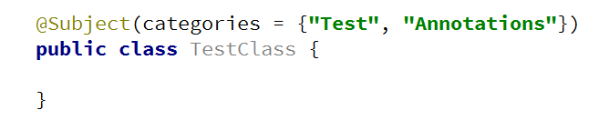
Problem: Create Annotation
Create annotation Subject with a String[] element "categories"
Should be available at runtime
Can be placed only on types

Slide 40
Solution: Create Annotation
@Target(ElementType.TYPE)
@Retention(RetentionPolicy.RUNTIME)
public @interface Subject {
String[] categories();
}

Slide 41
Annotations
Obtain class annotations
Obtain parameter annotations
Obtain fields and methods annotations
Annotation[] annotations = aClass.getAnnotations();
Annotation annotation = aClass.getAnnotation(MyAnno.class);
Annotation[][] parameterAnnotations =
method.getParameterAnnotations();
Annotation[] fieldAnots = field.getDeclaredAnnotations();
Annotation[] methodAnot = method.getDeclaredAnnotations();
Notes:
There are two ways to achieve abstraction
- Using Abstract Classes
- Using Interfaces

Slide 42
Accessing Annotation (1)
Some annotations can be accessed at runtime
@Author(name = "Gosho")
public class AuthoredClass {
public static void main(String[] args) {
Class cl = AuthoredClass.class;
Author author = (Author) cl.getAnnotation(Author.class);
System.out.println(author.name());
}
}

Slide 43
Accessing Annotation (2)
Some annotations can be accessed at runtime
Class cl = AuthoredClass.class;
Annotation[] annotations = cl.getAnnotations();
for (Annotation annotation : annotations) {
if (annotation.annotationType().equals(Author.class)) {
Author author = (Author) annotation;
System.out.println(author.name());
}
}

Slide 44
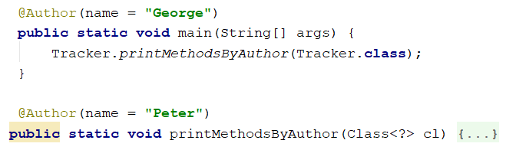

Problem: Coding Tracker
Create annotation Author with a String element "name"
Should be available at runtime
Should be placed only on methods
Create a class Tracker with a method:
public static void printMethodsByAuthor()

Slide 45
Solution: Coding Tracker (1)
public class Tracker {
public static void printMethodsByAuthor(Class<?> cl) {
Map<String, List<String>> methodsByAuthor = new HashMap<>();
Method[] methods = cl.getDeclaredMethods();
for (Method method : methods) {
Author annotation = method.getAnnotation(Author.class);
// Continues on next slide

Slide 46
Solution: Coding Tracker (2)
if (annotation != null) {
methodsByAuthor
.putIfAbsent(annotation.name(), new ArrayList<>());
methodsByAuthor
.get(annotation.name()).add(method.getName() + "()");
}
}
// TODO: print the results
}
}

Slide 47

Summary
What is Reflection
Reflection API
Reflecting Classes, Constructors, Fields, Methods
Access Modifiers
Annotations
Used to describe our code
Provide the possibility to work with non-existing classes
Can be accessed through reflection
…
…
…

Slide 48
Questions?
Notes:
48

Slide 49











SoftUni Diamond Partners

Slide 50



Educational Partners

Slide 51
Trainings @ Software University (SoftUni)
Software University – High-Quality Education, Profession and Job for Software Developers
softuni.bg
Software University Foundation
softuni.foundation
Software University @ Facebook
facebook.com/SoftwareUniversity
Software University Forums
forum.softuni.bg
51
Notes:
51

Slide 52

License
This course (slides, examples, demos, exercises, homework, documents, videos and other assets) is copyrighted content
Unauthorized copy, reproduction or use is illegal
© SoftUni – https://about.softuni.bg
© Software University – https://softuni.bg
Notes:
52

